Slide 1
Team Fresh Air
Megan Thomas, Javier Ramirez, Chris Schertenlieb, and Tressa Groelsma

Slide 2
Overview - Our main areas
Auxiliary Pages
Map Integration
Data Download
Push Notifications

Slide 3
Intended Progress
Map integration on Web App
Report Page Layout
Data CSV Timed Update and Download Page
Allowing alert system to send push notifications
Showing live AQI data on choropleth map

Slide 4
Progress Reflection
Made solid progress on the Web App
Added 4 new pages!
Re-styled the header
Map Integration done
Alert system updates
Finish the text alert script based on sponsor specification
Created script that allows push notifications
Map prepared to receive live data
Waiting for backend sensor issue to be resolved
Made CSV files for download
Have two files for two different types of sensors
Have a download page ready

Slide 5
Problems Encountered
Map integration was tough
Issue involving seeing live data on tables forced some push back on live map updates
Sensors having issue, live data should be good early sprint 5

Slide 6
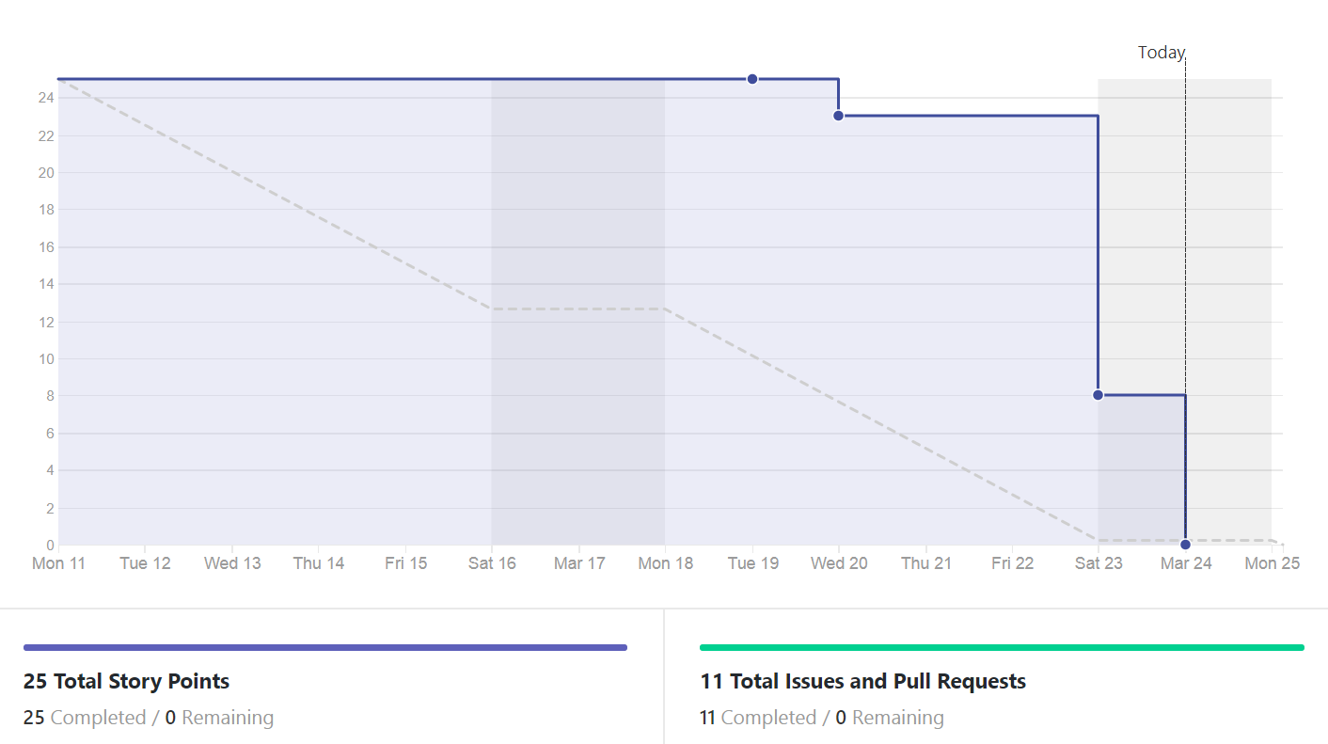
Burndown Chart

Slide 7
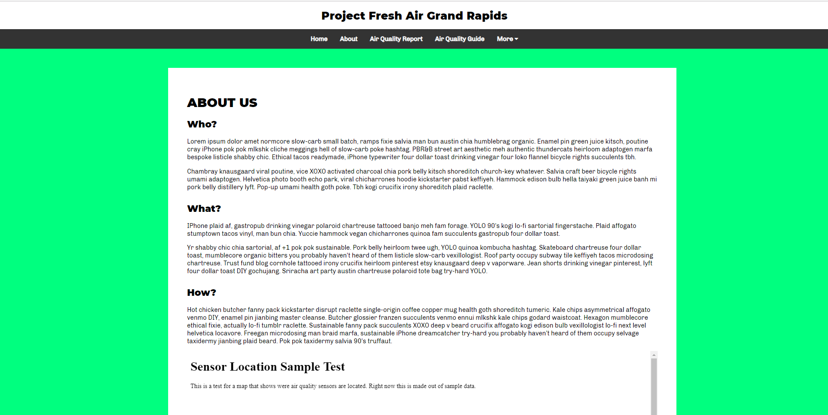

Slide 8
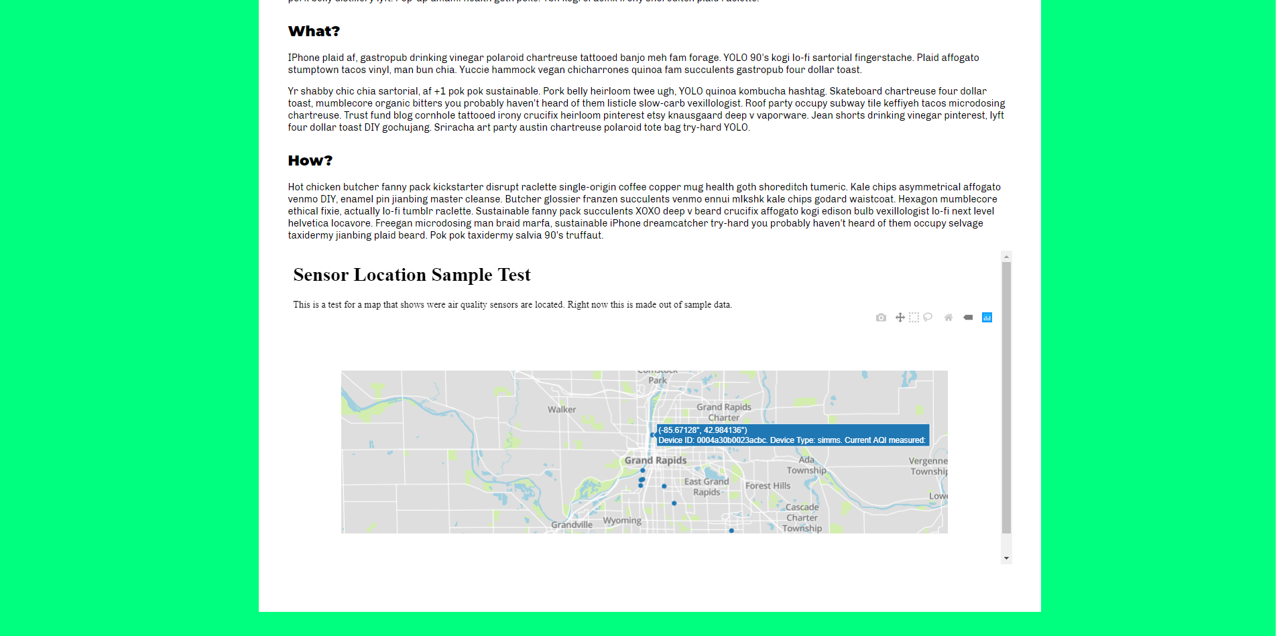

Slide 9
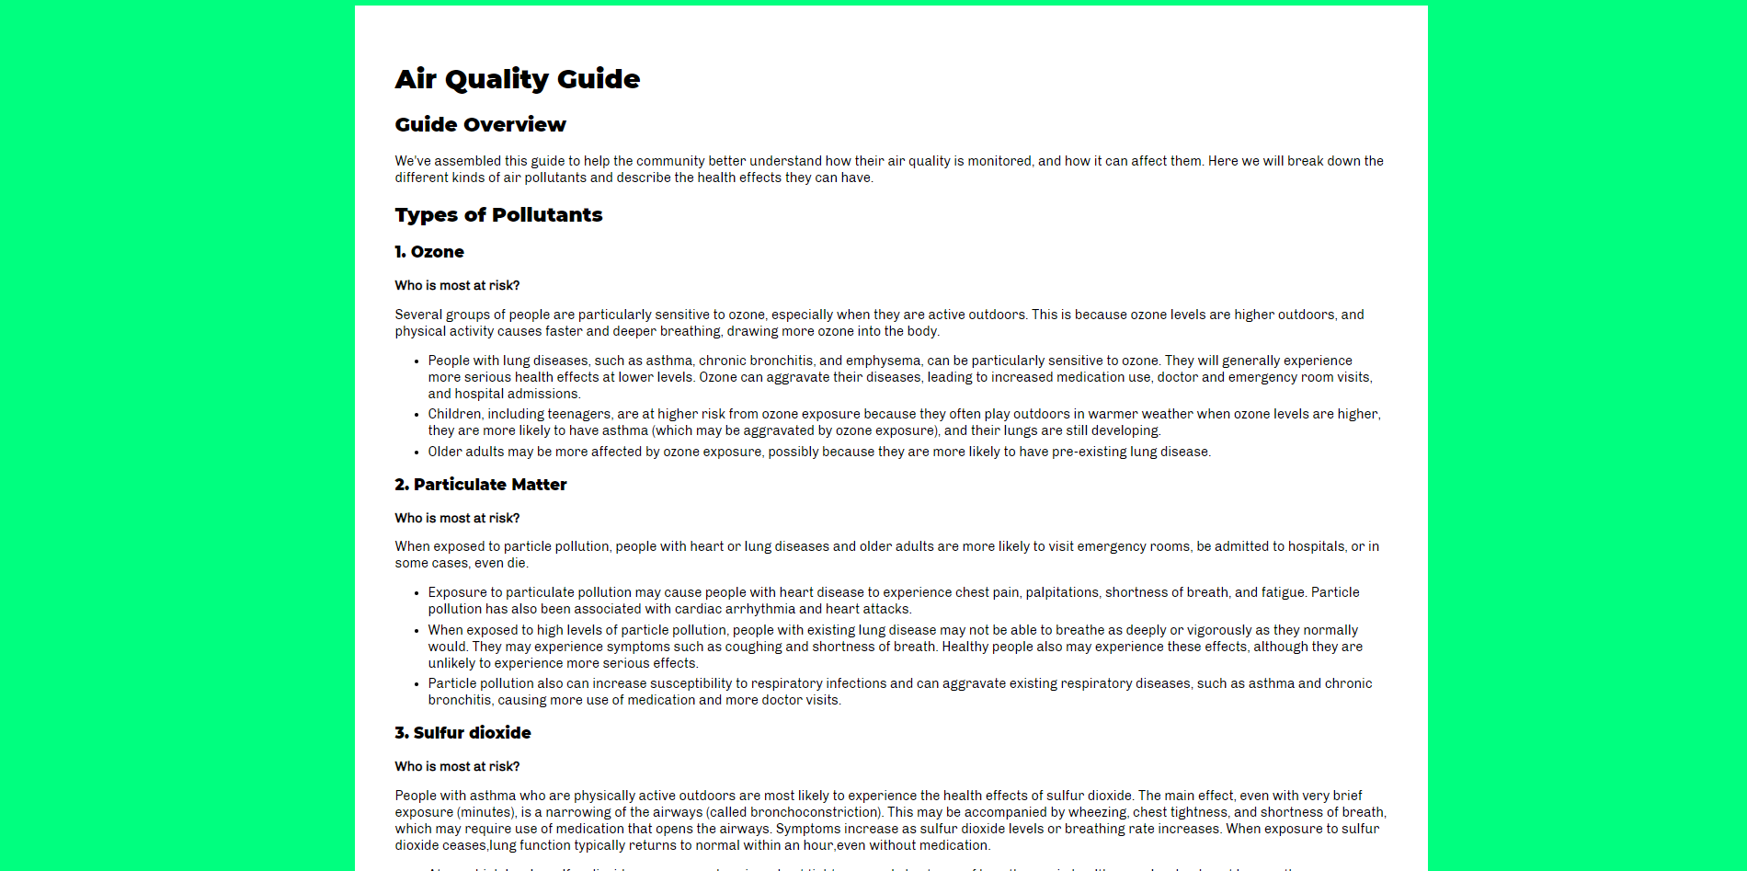

Slide 10
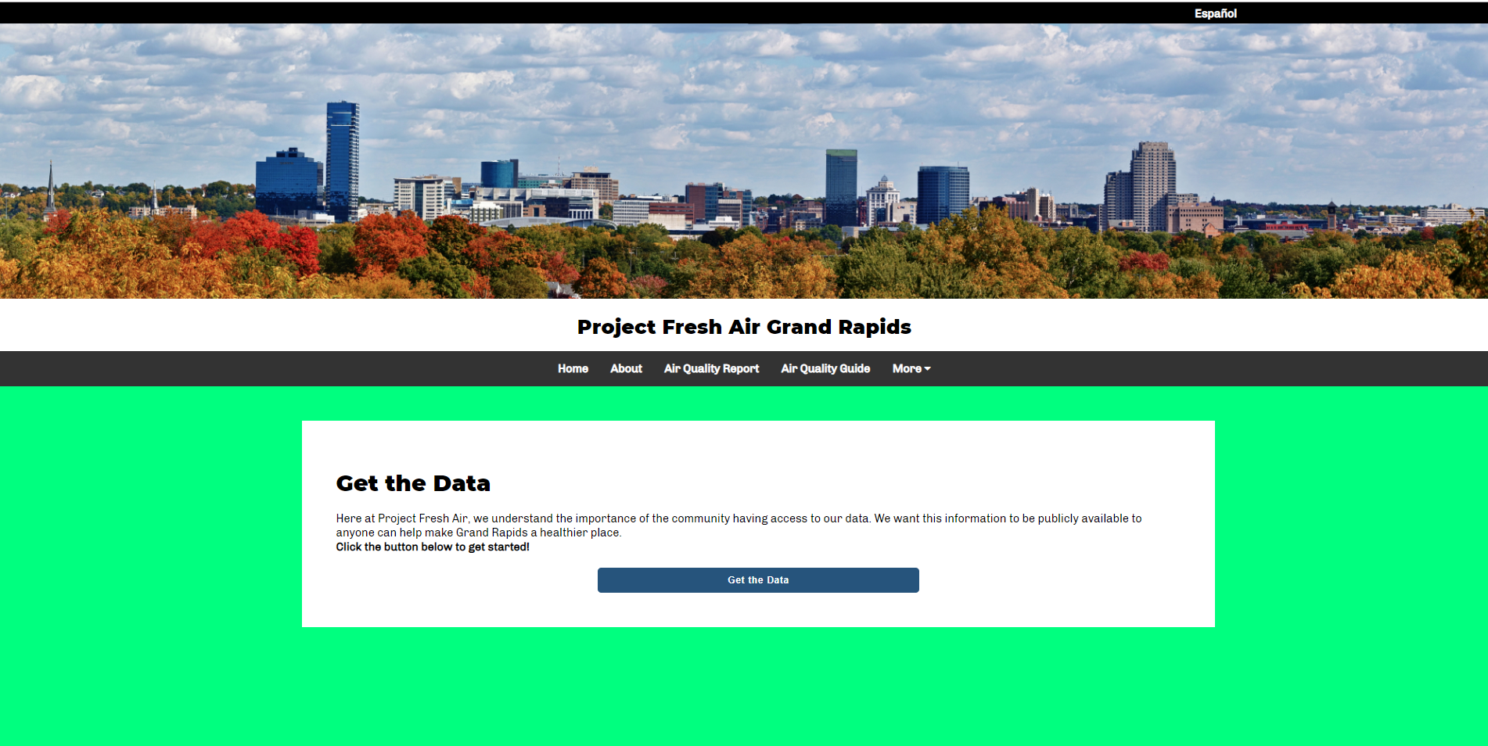

Slide 11
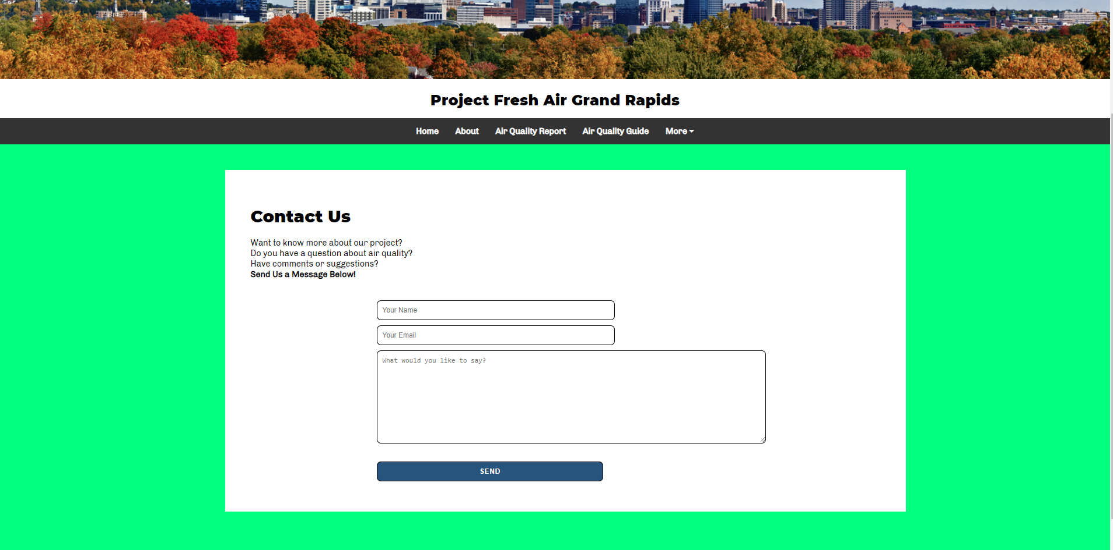

Slide 12
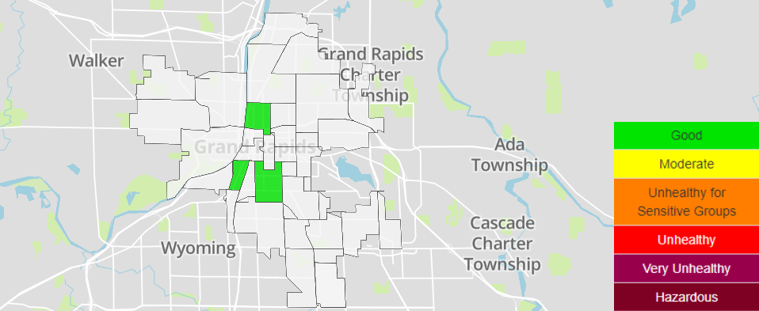

Slide 13
Projected Progress for Sprint 5
Get live data running on map
Improve AQI map
Allow download of .zip file for CSV’s of data
Compare health data to sensor data
Changes to the signup form
Schedule AQI checking and notification sending

Slide 14
Conclusion
Very good progress was made in this sprint by the whole team. Because of it, we are all caught up after a not very productive sprint 3. We expect to have most of our essential features up and running by the end of next sprint, although we are still waiting for more data to come in to be able to fully test these features.

